Slide 1
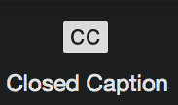
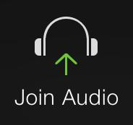
WELCOME
HOW TO HOST A VIRTUAL CONFERENCE (PART 1)
WE WILL BEGIN SOON, AT 7 PM ET.
ASK QUESTIONS EITHER BY TYPING IN Q/A OR RAISE YOUR HAND TO ASK IN ASL (WAIT FOR US TO CALL YOU TO SHOW YOUR VIDEO).
ONCE WE BEGIN, AUDIO & CAPTIONING WILL BEGIN -- RIGHT NOW, NO ONE IS VOICING.
Notes:
TIPS

Slide 2
HELLO!
Notes:
Angela, Sara, Lizzie intro self

Slide 3
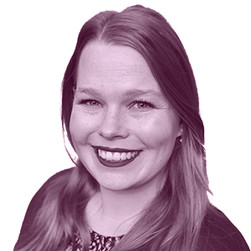
BEFORE WE GET STARTED...
Notes:
CC/Audio: CC at the bottom of your screen - you can move it around. Need audio? We have voice interpreters.
If have questions - How to ask Q/A english vs how to ask in ASL. Hold until end please!
Drag gray bar if we are screen sharing so you can see presenter and the shared screen better
We will not have chat available.
We’re not experts in zoom but this is what we learned in COR - information will be very overwhelming, we know! We will have a recording of this webinar and we will share it with you after to review again and again!

Slide 4
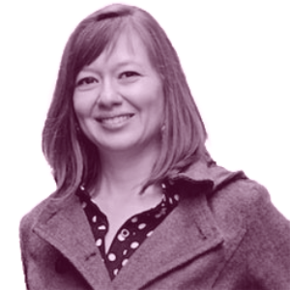
PART 1
OVERALL ZOOM REVIEW
MEETING vs. WEBINAR
SETTINGS
VISUALS
LIVESTREAM
POLLS
RAISE HAND FEATURE
BREAKOUTS
ZOOM ROLES
PART 2
BUDGET
ACCOMMODATIONS
WORKFLOW
LIMIT VIEW TO SPECIFIC GROUP
PRIVATE CHANNELS
VIDEO TIPS
DRY RUNS
Notes:
Part 1 - will present today. Part 2 will be March 15th, same time. Have questions about that? Please jot down and hold until that presentation. Miss presentation? We will provide a recording.

Slide 5
DEMO ZOOM
(Screen share)
Notes:
Sara will expand more on this.

Slide 6
HOW TO DECIDE:
MEETING or WEBINAR?
Notes:
How to decide? Meeting or Webinar? Now is not the time to make a decision but I will explain the difference between the two. We have more to share with you and at the end, you can decide what would be the best fit for your conference planning.
Note: Must start with a Zoom Pro License (Paid). Large Meetings and Webinars are optional add ons to the license. I will share more on the specifics later in this session.
Large Meetings: Large meetings are built for small to large team discussions and collaboration. Large Meetings are used for large business meetings, team building, chatting, etc.
Cons: Large Meeting platforms are not iPad & Iphone friendly. IPad and Iphone can only see four people at a time, and must swipe to find presenters. Graphics are difficult to see. You can pin or spotlight one person to look at but sometimes doing screen shares & switching presenters/interpreters is difficult. Be mindful of how many people you intend to have at the same time.
If you are mindful of the goal to keep few people on screen at the same time, you must also be prepared for people who might join the meeting late or start their video to comment. It can become distracting and disruptive. People may not be Zoom-Savvy so they don’t know how to use zoom and can unintentionally become disruptive. You will need to provide training on how to enter the room with your video off. You might need a co-host to force off screen if necessary.
Webinars: Webinars are used to host virtual presentations and broadcast them to a view and listen only to the audience. It reduces disruptions and is a safer choice. Webinars are great for board meetings, small business meetings, workshop presentations, plenaries, and modified Townhall sessions.
Cons, it is very restrictive for participants. They cannot see each other on the participant list.
Can up to 100 panelists including speakers, accomodations team, etc. Can’t run more than one webinar on one license. If you want to have two or more at the same time, you must purchase multiple HOST licenses.
Pro: People who are not experienced with zoom may have an easier time with Webinars.
Webinars are more simpler but at the same time more restrictive.
Meetings are more complex with many people varying skills and knowledge but can do more.
You need to visualize your conference and what you are looking for. If you want people to be more interactive, you might want to do the Large Meeting approach and set guidelines in place and add more people to help manage participants. If you feel a lot of your attendees would struggle with zoom settings, I suggest Webinar. You also need to ask your members what devices they have.

Slide 7
DEVICES?
LAPTOP, DESKTOP, IPAD, IPHONE, CHROMEBOOK, WEB BASED?
That’s a lot! DO DO?
Notes:
First, I strongly recommend that you try your best to have your participants download Zoom to their computer. Zoom app is all inclusive. Web based access is very limited. It is limited with chat, breakouts, captioning, side by side mode for screen sharing and etc. Zoom.us has more in depth chart. We also recommend training.
As for devices:
Laptop, Desktop (mac or PC) is the best.
Ipad is okay but only max 4 screens at same time. Maybe screen share not friendly and hard to see signers.
Iphone - same as IPad but smaller! iPhone user may become frustrated. Understand that not everyone have laptop or desktop and will use ipad/iphone so you need to have a goal to limit how many screens shown with ipad in mind.
Chromebook is not zoom-friendly. Chromebook can do breakouts but you cannot pre-assign. You’ll have to manually move the Chromebook user in their room. Chromebook has less features than others.
Chromebook is limited with chat, breakouts, captioning, side by side mode for screen share.
There are options - you can ask your membership what devices they have. State Associations can decide to lend devices for those who struggle with access.

Slide 8
SETTINGS!
(ZOOM ACCOUNT vs MEETING vs WEBINAR)
GALLERY vs SPEAKER VIEW
SPOTLIGHT vs PIN
REGISTRATION CAPACITY
EMAIL CONFIRMATIONS
Notes:
Will explain all of this then move on to the next slide.

Slide 9
SETTINGS!
ZOOM ACCOUNT, MEETING, & WEBINAR
What’s the difference?
Notes:
Your Zoom Pro (Free & Paid) account has a ‘global’ setting that applies generally for regular Zoom meetings. With Paid, you get more setting features. Most of your settings will apply to Large Meetings. You use Zoom Settings to adjust the waiting room, passcode, etc. Too many to mention. Few important settings are muting all participants when they join a meeting.
(Important for voice interpretation), chat settings, allow adding co-host, polling, non-verbal feedback, meeting reactions (raise hand), breakout rooms, captioning, and many more. Really too many to mention. It is really important that when you set up a webinar or large meeting, you should also check the general setting and be sure they are set to accommodate webinar/large meetings or if can’t because of other meetings before your webinar, be sure its all set up right before the large meeting begins. Add it to your pre-conference checklist!
Large Meetings currently are set up for up to 100 participants but you can upgrade your plan to add on 500 more people or even 1000! If you decide to schedule a meeting, see the button to schedule a meeting. Type in everything you want in this meeting. Settings will vary for you all. It is important to read all settings. If there are any that you are puzzled, Zoom Support has information & description. At first, awkward but the more you work with Zoom, learn about different settings and so forth, the more comfortable you will be. In Meetings, if you plan on breakout rooms, it is where you would be setting up the breakout rooms and even pre-assign! If you require registration, you need to check the box then create a meeting. Go back to that meeting and adjust registration. This is where you will manage registrants.
You want to create a webinar? Go to the sidebar and click on the webinar. If you are already upgraded to a Webinar plan, you will be able to see a button ‘Schedule a Webinar’. If you don’t see it, it means you need to upgrade your plan. You treat this webinar the same way as setting up meetings. You can enable a practice session where you can open up the room but it is not ‘live’ until you click to broadcast/open the WEbinar. It is a great way to allow panelists in the room like interpreters, presenters, etc and get them all set up and ready to go before allowing participants in the room. Registration for Webinar is very similar.

Slide 10
GALLERY vs SPEAKER VIEW
What’s the difference?
(PLAY VIDEO)
Notes:
Show video: Gallery vs Speaker after I explain briefly. The video is a great explanation.

Slide 11
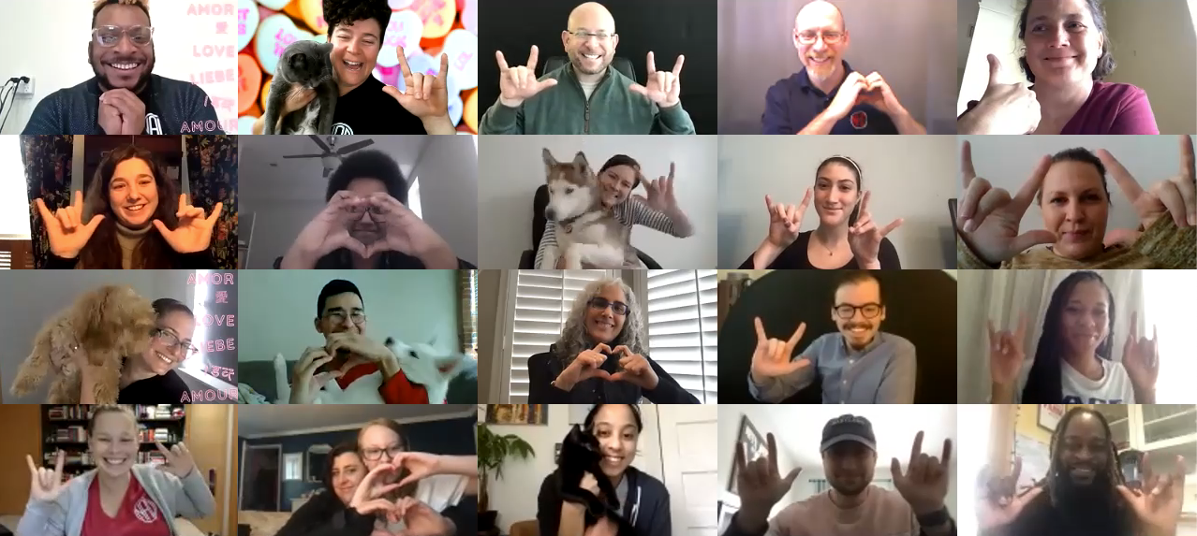
GALLERY VIEW
Notes:
SHOW VIDEO

Slide 12
HIDE NON-VIDEO PARTICIPANT
(PLAY VIDEO)
Notes:
SHOW VIDEO

Slide 13
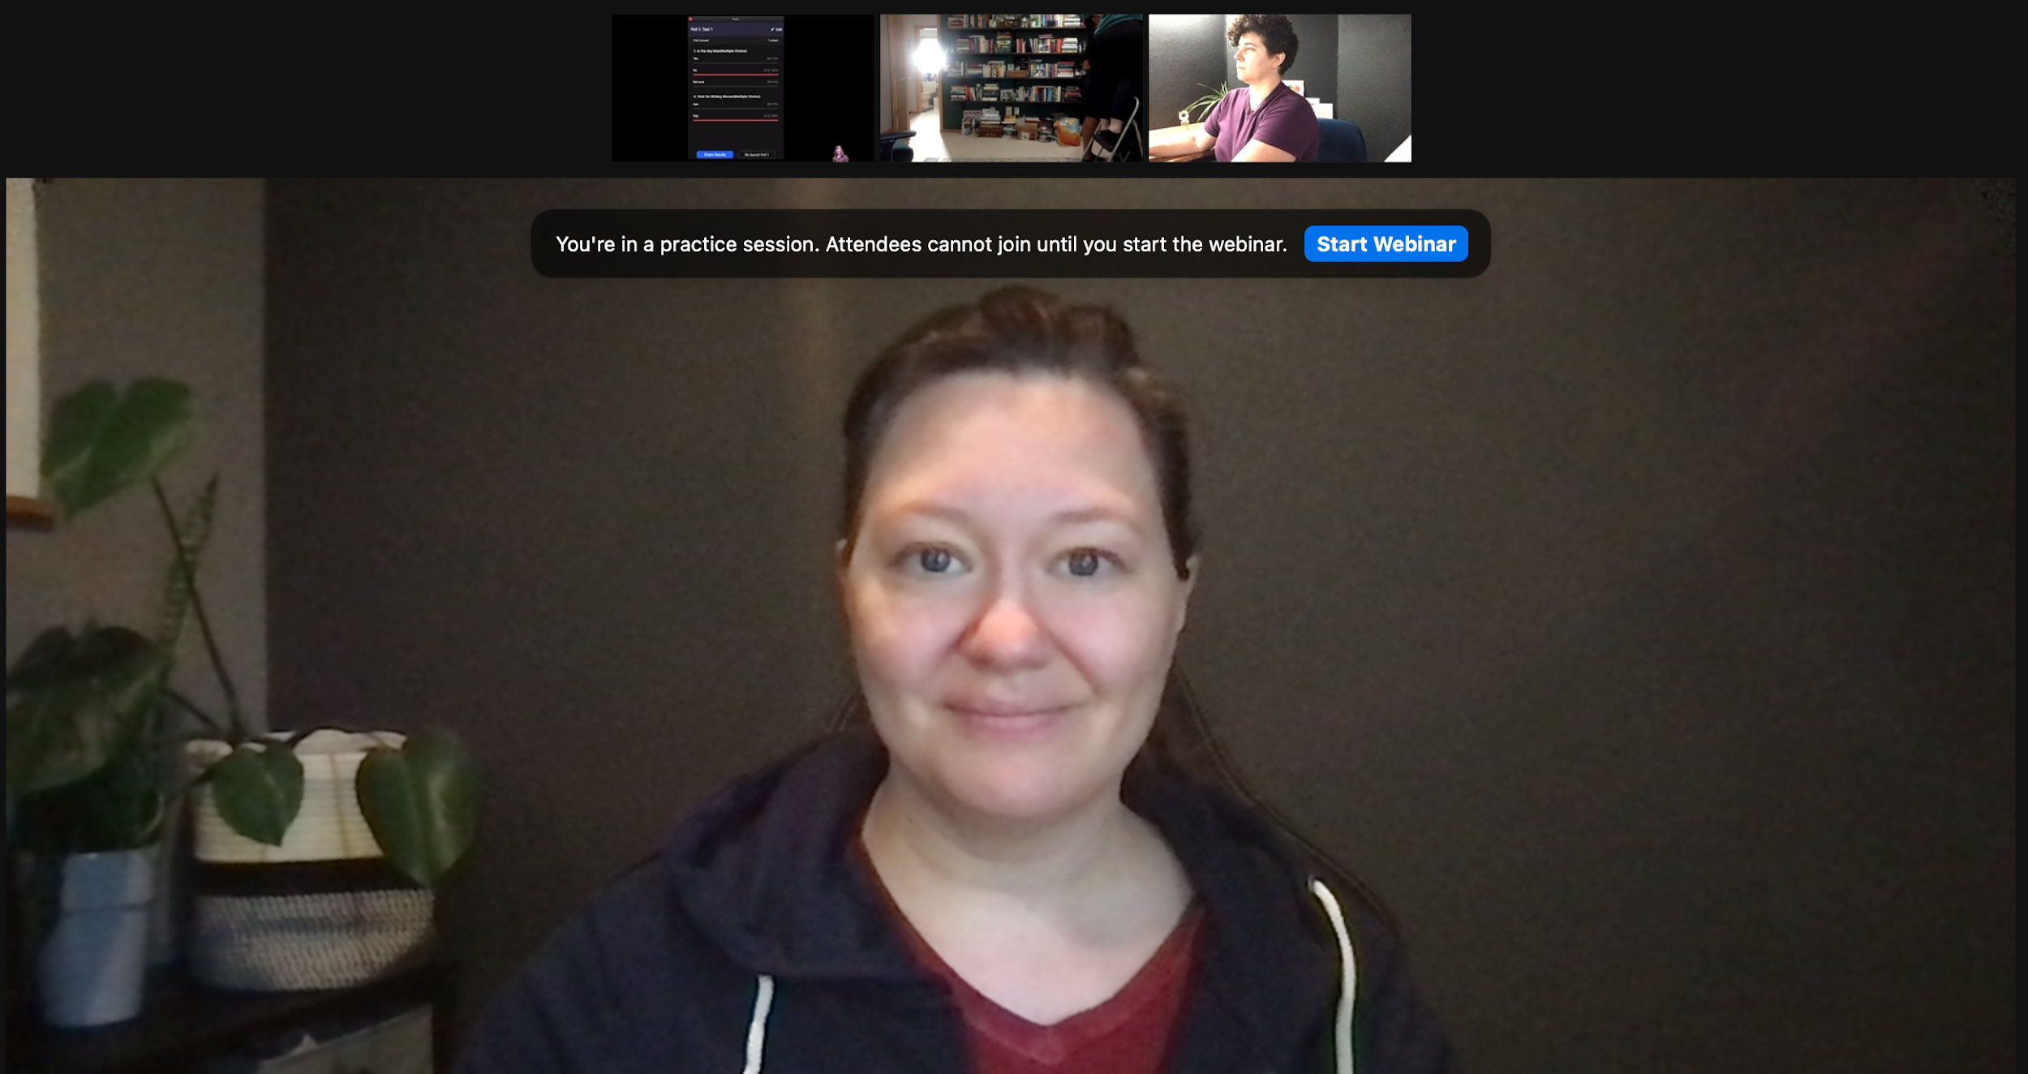
SPEAKER VIEW
Notes:
Show video: Gallery vs Speaker after I explain briefly. The video is a great explanation.

Slide 14
SPOTLIGHT vs PIN
What’s the difference?
Notes:
SPOTLIGHTING:
To prevent screen switching due to audio- . Have all participants in the room be muted. Host and Co-Host will need to monitor that. Typically for a ASL only conference, only the interpreters would have the mic on for CART/audio access.
However, Pinning can help.
PINNING: Any participant can pin other participants videos as long they are in gallery view! They have the control to make it access-friendly! Pinning will override Spotlighting.
In Meetings, host can pin and spotlight up to 9 videos. It will off speaker view and force participants to see up to 9 speakers. Participants can only pin one video on their end.
Host can allow participants to multi-pin. Usually participants only can pin ONE person. However, if Host allow multi-pining, people can pick what they really want to watch out of many presenters. This may be beneficial for participants who need to multi-pin for accessibility purposes. Ex. I want to see presenter and CDI. I will pin the presenter and CDI to ensure the two screens or more stays on during the entire duration. We encourage only up to 4 screens at once including a screen for interpreters.

Slide 15
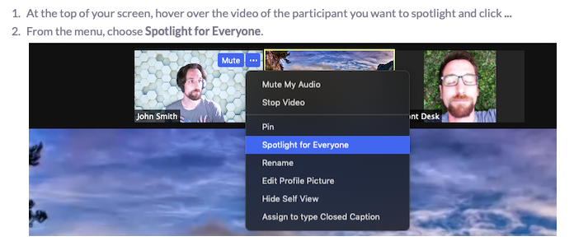
SPOTLIGHT
PIN
Notes:
SPOTLIGHTING: Host/Co-host can only spotlight someone. If spotlighting a presenter, it forces participants to see the presenter and limit what the participant sees. If a participant prefers Gallery View, this approach takes away that control. We have many participants with unique preferences and needs. I’m not fond of that approach because it makes it one standard for everyone and it is not access-friendly. Speaker view will force anyone who has audio on to appear first and if someone else starts speaking, the view will switch to that person. Host will usually use the Spotlight view to force everyone to see that speaker and ignore the audio cues. New feature that host can spotlight up to 9 people. I think it’s a great feature but with limitation. Up to 4 on one screen and be absolutely sure that participants are fine with the 4 people you spotlight. It may be an access barrier for DeafBlind folks.
To prevent audio issues. Have all participants in the room be muted. Host and Co-Host will need to monitor that. Typically for a ASL only conference, only the interpreters would have the mic on for CART/audio access.
However, Pinning can help.

Slide 16
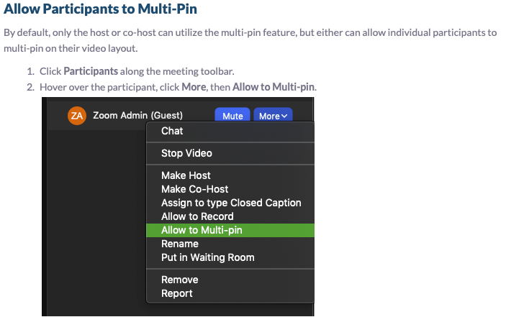
MULTI-PINNING - HOW?
Notes:
I recommend allowing multi-pinning as a host especially in large meetings. You allow people to be able to pick what they want to see. For instance, participant can pin a CDI so that the CDI will always remain on screen. They can also pin additional CDIs, speakers, etc.

Slide 17
REGISTRATION CAPACITY
Notes:
Capacity depends on your plan size - 100, 500, 1,000, etc. You can have unlimited registration or set a registration limit. You can verify the number of your room to be sure.

Slide 18
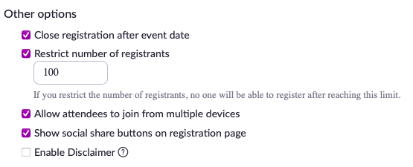
REGISTRATION CAPACITY
Notes:
Suggest set registration limit according to plan size. Zoom may accept more than 100 (example) and they will either ask you to upgrade your platform OR block people from entering the room if over 100. Avoid that by managing your capacity and reduce issues at time of meeting. Worrying about that is not worth your time during meetings. Decide in advance what numbers you are setting.

Slide 19
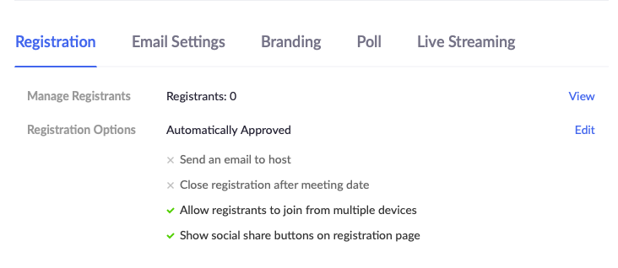
REGISTRATION CAPACITY
Notes:
Registration - three options to manage registration.
Registration is not required, attendees will get a URL and have to enter their name and email to join.
Can automatically approve anyone who registered and Zoom will send confirmation email with link.
You can manually approve attendees then Zoom will send out confirmation email. Go in manage attendee or manage registrants, click Edit. Will see list of registrants and three categories: Pending Approval, Approved, Denied/Blocked. Go in Pending Approval and you can see list of unapproved registrants. Click on their name to review registration details and then approve/deny their registration. You can approve or deny in bulk by pick multiple reg and click approve or deny button.

Slide 20
EMAIL CONFIRMATIONS
Notes:
Email confirmation is custom! You can go in and edit what the email confirmation should look like and then these emails will go out to approved registrants depending on the settings you have for the approval process.
For Webinars: If approved participants get their email, great! They can click on the link to join the Webinar.
For Meetings: Same concept, you need to approve their registration, they get email confirmation and then they can click on link and enter the room when it’s time. Based on my experience, sometimes they may have issues accessing zoom when their link does not work. You may need to go back in their registration details and verify that their approval true biz through. If it did not go through, you’ll have to manually approve their registration then copy their link and email directly to them. You can also resend confirmation email.
Your registration & help/tech staff will need to be ready when you are accepting people in the Zoom room in case anyone have issues.
SCREEN SHARE DEMO

Slide 21
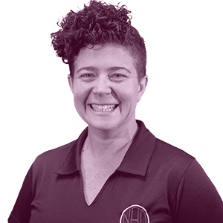
VISUALS

Slide 22
SCREEN SHARING
FYI: SCREEN-SHARING DURING LIVESTREAM MEANS PANELIST WINDOW WILL BE SMALL, VIEWERS CAN’T ADJUST
Notes:
Note: some devices can’t handle production of videos/images

Slide 23
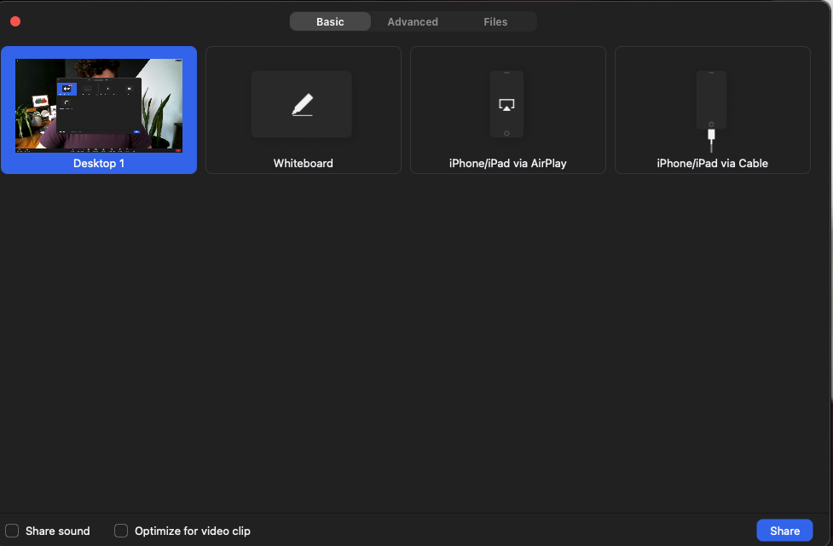
SCREEN SHARING: BASIC
Notes:
Note: some devices can’t handle production of videos/images

Slide 24
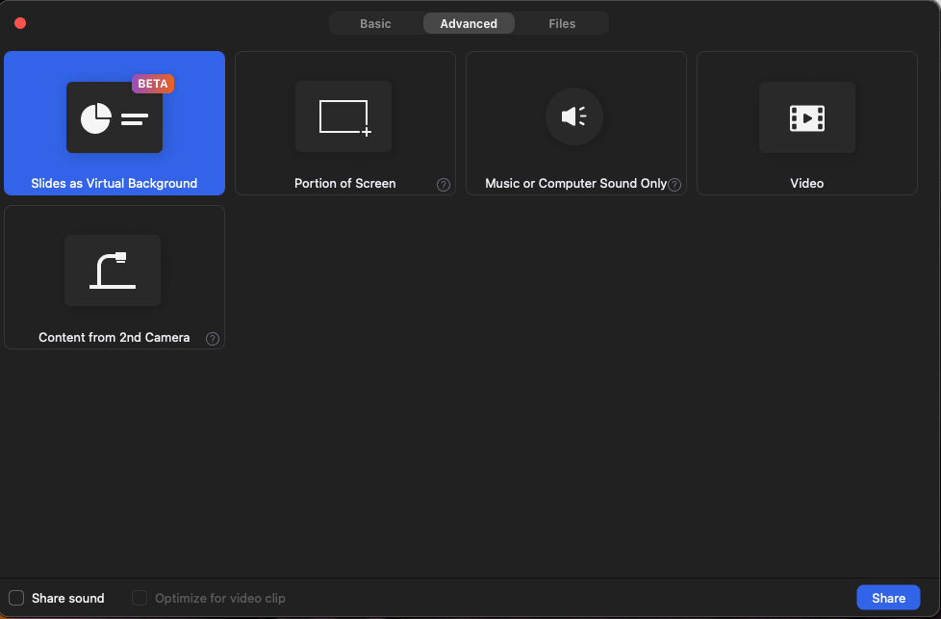
SCREEN SHARING: ADVANCED
Notes:
Note: some devices can’t handle production of videos/images

Slide 25
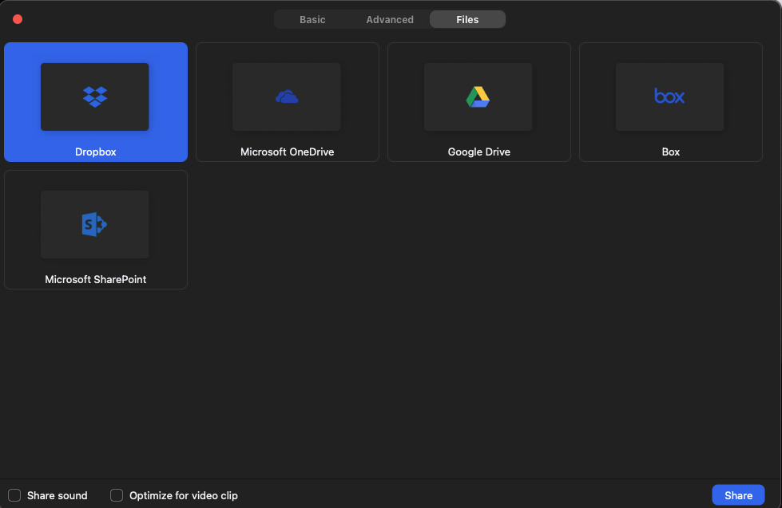
SCREEN SHARING: FILES
Notes:
Note: some devices can’t handle production of videos/images

Slide 26
TIP!
COVER WEB CAM AND SHOW SLIDES INSTEAD
(EX. PLAY VIDEO)
Notes:
Note: some devices can’t handle production of videos/images

Slide 27
TIP!
USE SECOND WEB CAM TO SHOW LIVE TYPING
(EX. MINUTES)
Notes:
Note: some devices can’t handle production of videos/images

Slide 28
LIVESTREAM

Slide 29
LIVESTREAM:
Notes:
- show where can start Livestream on FB/YT (screenshot) - WHEN STREAMING WILL SEE “LIVE ON FACEBOOK NOW” or “LIVE ON YOUTUBE”
ONLY HOST CAN DO THIS

Slide 30
LIVESTREAM
Notes:
- example screenshot of how settings on FB / YT
- what livestream looks like on FB / YT
- if over capacity, can give link to live stream - FB not need to have users sign up for account.
- communicate where watch
- keep in mind, livestream forces panelist window SMALL when screensharing -- work around by showing via screen
- set up LIVE tab button on your facebook page (https://www.facebook.com/business/help/629164494303277?id=1123223941353904)

Slide 31
LIVESTREAM: FACEBOOK VS. YOUTUBE?
WHAT ARE THE DIFFERENCES?
CAPTIONS
RECORDING
Notes:
- difference between FB / YT live streams
- FB captions, meh- why? ASR. if their webinar/meeting has voice interpreters and a captioner, make sure you ask captioner in advance that you'll need .srt after event and re-upload .SRT file later
- YT captions become OC, can’t remove or edit after livestream ends.
COR - did have situation couldnt stream to facebook, we used YT as back up
- Zoom recording vs video stream
Can use livestream to archive video on social media or download package from there but if want specifics can click record zoom to cloud or to computer then download Zoom videos - can choose from gallery view, speaker view etc. can also include chat history, poll history etc. have options.

Slide 32
POLLS
DEMO
Notes:
Polls - Allows you to create single choice or multiple choice polling questions for your meeting and webinars.
Some limitations:
Hosts can create polls, Co-host cannot create.
only 25 polls per webinar. If you run out of polls, you will need to shut down the webinar and restart again and make sure everyone is back in the room. Plan out your polls carefully.
Explain COR Issue.
Max 10 questions per poll.
You can pre-create or create during meetings and launch. Polls can be anonymous or download a report during and after the webinar.
Host and Co-Host can launch the poll but cannot vote. Host can decide if panelists can vote or not.
Launch cookies poll
Screenshare to show how to set up polls (Favorite Colors Roy G. Biv)
Note: Lock Meeting.
Note: Polls is not DeafBlind friendly. I will go into more details in part 2 but summary - wording is small. This participant will need a proxy vote (meaning someone else will need to support on voting) or more time to read the questions and make their choice. CONAVIGATOR.

Slide 33
OTHER TYPES OF FEEDBACK
RAISE HAND
NONVERBAL FEEDBACK
Notes:
Other than Polling, there are other ways you can collect voting and feedback. We have the Raise hand function, NonVerbal Feedback and Meeting Reactions.
*Meetings can do Polling Raise Hand, NonVerbal Feedback, and Meeting Reactions.
( Webinars only can do Polling & Raise Hand.
Participants can’t see raise hand, NVF, or Meeting Reactions in Meetings? It is possible that they turned it off in their own settings.
Host and Co-Hosts cannot raise hand, use nonverbal feedback or polls.
I will explain briefly about meeting reactions. Meeting reactions is emoticons and it has to be enabled by the Host. Participants can pick any emoticon to show their reaction but it only lasts for 10 seconds. It's more for fun and not a good way to collect voting.

Slide 34
RAISE HAND
Notes:
Raise Hand is a form of nonverbal feedback. It is not controlled by NonVerbal Feedback. It is a separate function. In meetings, it cannot be disabled. In Webinars, it can be disabled. Raise Hand is a great way to let hosts and presenters know that you would like to say something. The raise hand button is always found on the bottom of the Zoom app window. In webinars, if it’s turned off, it won’t be there. It could be considered voting but it is easier to use Polling or NonVerbal Feedback.

Slide 35
CHANGE SETTINGS DURING..
Notes:
Host & Co-Host Controls - might look different w Meetings and Webinars
Can control chat.
Lock room
Allow attendees to raise hand. You can also lower all hands raised.

Slide 36
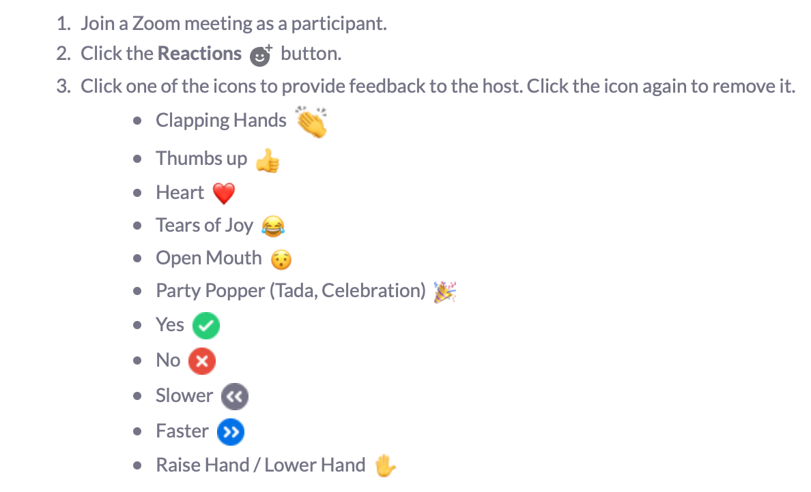
NONVERBAL FEEDBACK
Notes:
This is only for meetings. NonVerbal Feedback is also a nice way to collect voting. You can see how many people picked Yes or No. This is only available in Meetings not Webinar. Host and Co-hosts can see how many people chose Yes or No or other icons.
It is also a great way to tell host that the meeting is too fast, something to keep in mind for accessibility.

Slide 37
BREAKOUTS
(only for Meetings)
LIZZIE SCREEN SHARE ZOOM SETTINGS
Notes:
Lizzie screen share
CHAT: Share, https://support.zoom.us/hc/en-us/articles/360032752671#h_f1d7287d-ade8-4b73-b0b9-37365faecf55

Slide 38
ZOOM ROLES
(HOST vs CO-HOST)
LIZZIE SCREEN SHARE EXCEL

Slide 39
Q/A

Slide 41
WORKSHOPS vs BUSINESS

Slide 42
SHARING REPORTS IN ADVANCE

Slide 43
HOW LIMIT VIEW TO SPECIFIC GROUPS?
(members vs non-members)

