Slide 1
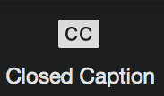
WELCOME
HOW TO HOST A VIRTUAL CONFERENCE (PART 2)
WE WILL BEGIN SOON, AT 7 PM ET.
ASK QUESTIONS EITHER BY TYPING IN Q/A OR RAISE YOUR HAND TO ASK IN ASL (WAIT FOR US TO CALL YOU TO SHOW YOUR VIDEO).
ONCE WE BEGIN, AUDIO & CAPTIONING WILL BEGIN -- RIGHT NOW, NO ONE IS VOICING.

Slide 2
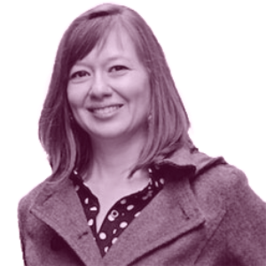
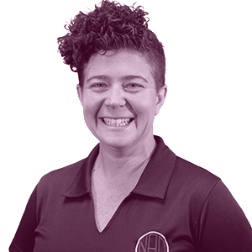
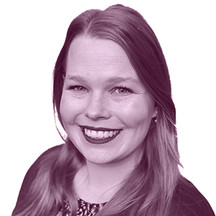
HELLO!

Slide 3
BEFORE WE GET STARTED...
(screenshare testing 1, 2, 3)
Notes:
HOUSEKEEPING TIPS: (SARA)
SCREENSHARE TEST explain what happened part 1 brief - CAN YOU ALL SEE US OKAY?
CC/Audio: CC at the bottom of your screen - you can move it around. Need audio? We have voice interpreters.
If have questions - How to ask Q/A english vs how to ask in ASL. Hold until end please!
Drag gray bar if we are screen sharing so you can see presenter and the shared screen better
We will not have chat available.
We will have a recording of this webinar and we will share it with you after to review again and again!

Slide 4
PART 1
OVERALL ZOOM REVIEW
MEETING vs. WEBINAR
SETTINGS
VISUALS
LIVESTREAM
POLLS
RAISE HAND FEATURE
BREAKOUTS
ZOOM ROLES
PART 2
WORKFLOW
WORKSHOPS
SHARING CONTENT
REGISTRATION REPORTS
BUDGET
SMALL GROUP VOTE ONLY, HOW
PRIVATE CHANNELS
TIPS BEFORE STARTING
DRY RUNS
ACCOMMODATIONS
Notes:
We discussed Part 1. Miss part one? Worry not. We have recordings and will share. Part 2, discuss today.

Slide 5
WORKFLOW

Slide 6
WORKFLOW:
WEBINAR SET UP
PLANNING DOC (screenshare)
PANELISTS
REGISTRATION
SHARING
Notes:
setting up webinar
Crossing all Ts and dotting Is.
Q/A want on or off?
Checking information, timing and registrants
Checking panelists
planning doc
Creating an one stop doc where all the webinar information is listed with panelists (bio, photo, e-mail, pronouns etc), interpreters (e-mail) + any other additional people (CART or other language interpreters)
Include your talking points in the doc to share with CART and Interpreters.
Include any PPT links, description of webinar, timing of dry runs, social media information, any to-do list tasks etc. this can BE ANYTHING YOU NEED.
inviting panelists
If planning a dry-run, inviting all your panelists in advance is helpful.
Make sure to emphasize that panelists links are NOT TO BE SHARED with others!
registration link
This can be used on your organization’s website for registration.
Make sure you go through the registration settings for any customization you would like
announcing on social media/sending e-mail etc
Share your event with the community via e-mail blast or social media post. Plan this one out too! Any graphics or video announcements needed? Make sure you make that accessible!

Slide 7
WORKSHOPS
Notes:
Workshops
THINGS TO CONSIDER
Workshops - interactive? I suggest Meetings for Breakouts, NonVerbal Feedback, and a few other features that are not in Webinars. I want to remind you about multi-pinning. This is a great way to work in teams if you don’t want to do the breakout function. For instance, you can make a list of teams in advance, email to participants and let them know who their team members are. During team activities, teams can pin the slide, and their team members so they only see the presenter, slides, and their team. A little training on hiding non-video participants and pinning is required.
Workshops - only Present and View? I suggest Webinar.
How to access workshops - Think of ways to make accessing workshops and business meetings easy for your members. Some may not be tech savvy.
NCIL conference one link to access website. NCIL is a conference for people with various disabilities so we have to be mindful of accessibility. For instance, NCIL hired someone to build a website that are accessible. Many log in website require two step verification like the image selection or type in numbers letters to verify you are not a bot. This is not accessible to many so we developed a website eliminating that step process and they can only sign up after they register and receive a link to sign up. Only their email can access website. Going in, have an agenda with each workshop, each workshop has their own zoom link with supplementary materials.
There are many conference apps and websites that have info ready and built for you but not all accessible.
Other conferences did a calendar invitation to each workshop after registering.
Many options out there.

Slide 8
SHARING CONTENT BEFORE
Notes:
Minutes, candidates, proposals

Slide 9
HOW TO COMMUNICATE WITH PEOPLE BEFORE YOUR MEETING
Upload ASL reports to YouTube and share
Post on Social Media
Email members
List all reports on website for
convenience

Slide 10
DO WHAT NEEDS TO BE DONE
SO YOUR MEETING
WILL BE EFFICIENT!

Slide 11
REGISTRATION REPORTS
(screenshare)
Notes:
Screenshare where show download registration report
explain difference between registration report and attendee report
Before webinar/meeting: registration (good to compare with voting results match or not)
After webinar/meeting: attendee (can view when person arrive/leave, how long they stayed etc)

Slide 12
BUDGET

Slide 13
BUDGET: (screenshare)
VIRTUAL PLATFORM FEES
ACCOMODATIONS
SWAG BOX
CONFERENCE APP/WEBSITE
TECH SUPPORT

Slide 14
VIRTUAL TOUCH POINTS

Slide 15
WHAT IF ONLY A SMALL GROUP CAN VOTE?
(members vs non-members)
Notes:
This is focused on state associations so most of our state associate conferences include parliamentary procedure and voting. In person conferences - sometimes we allow non-members in the room just to watch but not vote. This is problematic for virtual conferences. We want to include non-members just to watch but not vote. Do do?

Slide 16
LIVESTREAM?
EXTERNAL FORM?
BREAKOUTS?
Notes:
METHOD 1:
Members - stay in zoom
Non-members - can watch live stream on Facebook or Youtube
Be mindful of people like interpreters, CART, board members that cannot vote. Tally that number against the membership that are currently in the room. Voting committee will need to watch the numbers. By making some people like interpreters, etc co-host means they cannot vote. Be careful because being a co-host and non-experienced with Zoom can cause chaos. Everyone who is not allowed to vote need to be clearly communicated to that they cannot vote.
METHOD 2:
Zoom platform and a separate voting platform like ballotrunner.com or GoogleForms.
If you want to screenshare and not do live stream. This is another option to consider. You need to be sure that your members are able to use their computer and phone to vote or switch apps. I can’t suggest specific names of voting apps because they have not been tested but there are many options!
METHOD 3:
Breakout method. Send non-members into breakout room when you need members to vote. Understand that people can leave breakout room to come back to main zoom room - be aware of that in settings don’t check “allow back in main room” if you don’t want this to happen.

Slide 17
PRIVATE CHANNELS

Slide 18
TIPS BEFORE STARTING
Notes:
What should participants / attendees need to know in advance of meeting/webinar -- email in advance? Show tips via playback during check-in?

Slide 19
ENSURE PARTICIPANTS WILL KNOW WHAT TO DO
host training sessions?
create a tutorial page?
play video of tips?
(AND IF NOT, BE PREPARED)

Slide 20
DRY RUNS
(AND MANY TESTS)

Slide 21
ACCOMMODATIONS

Slide 22
STANDARD ACCESSIBILITY GUIDELINES
Notes:
Standard Accessibility Guidelines:
This should be in practice at all times for yourself and all presenters.
Self introduction when it's your time to present. ‘Angela here’ so that the captioner knows who is speaking.
All should wear a solid color shirt that contrasts skin tone and the wall.
Plain background, no clutter, shelves, window, etc. Like mine.
Presentation materials should be clutter free, plain language, and easy to read.
Lighting is important. If you are in a dark room, it is hard to see and strain on the eyes. If you can see yourself well and etc then that means, others can see you well.
If you are using a virtual background, it also needs to be solid and be sure that you have a green background and check that you are using a green screen. Otherwise, if you fingerspell or sign out of your body range, it’ll be fuzzy.
Always be sure that your head and mid-torso is in the frame.
Your laptop should be stable.

Slide 23
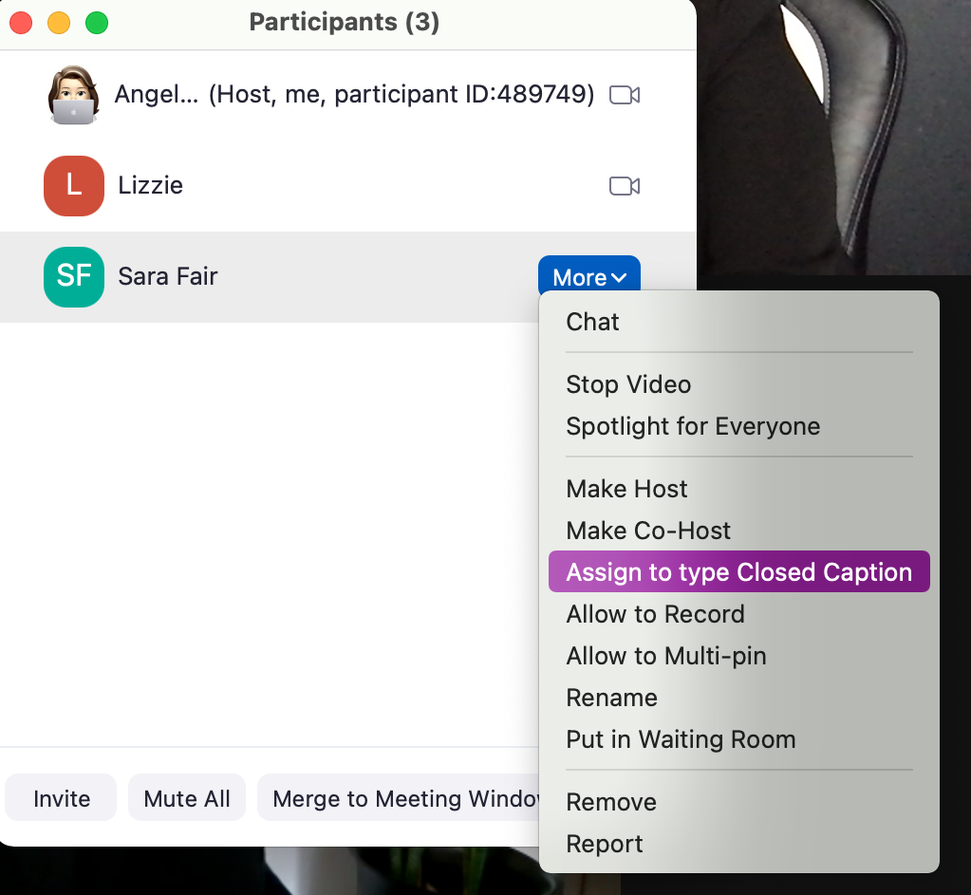
CAPTIONING
Notes:
Captionists:
- You can and should share materials, terminology and presenters names. Captionists will preload in the software and easily identify the presenter when it’s their turn to present. This is very important when you have multiple presenters. For instance, right now, you are seeing captions that reflect Lizzie, Sara, and my names. Captionists can provide transcripts & .SRT after. You will have this transcript to supplement meeting minutes as an example. Captionists will self-correct if there are errors and will clean up the transcript if needed. You must invite this captionist as a panelist in your webinar. Many pros. One con is that it costs money but I think the tradeoff is excellent and worth it.
ASR is cool and really handy in a pinch but it is NOT reliable, especially when presenters are not identified and do not have background information of the presentation. Who’s talking????
Lots of errors. One pro is it’s free or pays a small fee. Again, ASR is not reliable and it creates a LOT of frustration for your participants if they can’t even follow along and it creates more time for your staff to clean up the transcript after. .SRT may not be available.
How to turn on captioning?
Remember, first must toggle on captioning in your account in Zoom Web Portal. Go to Account Management then Account Settings, click on Meeting tab. Make sure Closed Caption is enabled (on). If it’s not on, toggle it on. We covered this in part 1, will provide recording.
Second, when you start meeting and the captionist is in the room, go to the Participant list, find the captionist name and click ‘more’. Pick ‘Assign to Type Closed Caption’
If you have breakout rooms - do do?
Breakout rooms can do captioning but only one room with one captionist. Breakouts can’t do ASR but can assign third party captionist (live). Important assign captioner to do the caption BEFORE doing the breakouts and then move the captionist to the correct breakout room to people who need. (can’t multiple)
Have more than one person using captions in multiple breakout rooms? Use streamtext. Ex. Two breakouts, two captionists. Two streamtext links.

Slide 24
STREAMTEXT
(screenshare)
Notes:
Streamtext is cool because it is more accessible than captioning in Zoom. I believe it is very important to offer both. People can pick and choose. Zoom captioning sizing can be adjusted. Streamtext is more friendly because you can adjust screen color, text color, and other formatting. Streamtext is very accessible to people with low vision. White captions with black font are hard for many. They can adjust to make it reader-friendly.

Slide 25
ACCOMMODATING DEAFBLIND PARTICIPANTS

Slide 26
Interpreting (Voice & DI)
Notes:
Interpreting (Voice and DI)
Voice interpreting - they must be invited as a panelist in a webinar. All microphones must be turned off. The interpreters will turn on their mics to switch speaking roles. If they are just voicing, they can keep their screen off but mic on. If they are signing/interpreting, they need to turn on their screen. (Rule of thumb, be sure to have less than 4 people with their screen on and that includes screenshare due to Ipad & Iphone limitations.) Team interpreters typically have their own private channel to support each other.
Deaf Interpreters are great because they can do different roles - platform interpreting, interpret for DeafBlind participants, or interpret for people who may need clarifications. Hearing interpreters can remain on a private channel and feed the Deaf Interpreter.
Both need to be invited as a panelist and maybe assign as cohost if necessary. Prior to Dry Run, clarify what works best.

Slide 27
DIFFERENT LANGUAGES
Notes:
Spanish voice interpreter: enable voice interpretation on webinar setting when setting up webinar. (SCREENSHOT)
Note: The pre-assigned interpreters must be signed-in to the account associated with the chosen email address. If they are not signed-in with that email address when joining the session, they will not be recognized as an interpreter; the host however can manually assign them to be the interpreter within the meeting.
Have options for many languages (searchable) - 9 default languages displayed:
English
Chinese
Japanese
German
French
Russian
Portguese
Spanish
Korean

Slide 28
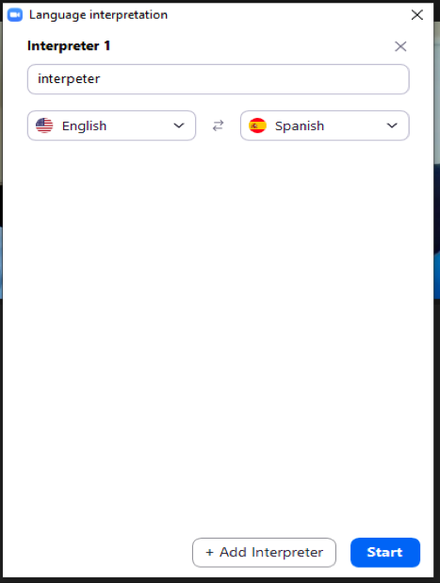
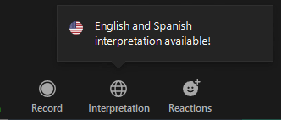
DIFFERENT LANGUAGES
Notes:
Once the webinar is in practice mode, before starting it, invite the participant to become the “voice interpreter” and audio options will appear. (ZOOM PHOTO)
Only host can assign voice interpreter

Slide 29
Q/A

